Slide 1
Heat Illness Prevention Training
Revised 10-2021

Slide 2
SCU Heat Illness Prevention Training
Course Outline
Section 1: Heat Illness
How the body handles heat
Types of heat illness
Risk Factors
Section 2: Prevention of Heat Illness
Access to Water
Access to Shade
Section 3: Response and Emergency Procedures
Notification Procedures

Slide 3
Section 1: Heat Illness
How the Body Handles Heat
Types of Heat Illness
Risk Factors

Slide 4
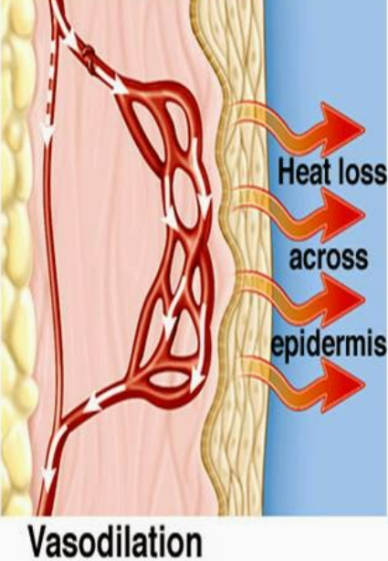
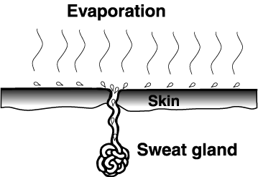
How the Body Handles Heat
In order to maintain a constant temperature in warm environments, the human body rids itself of excess heat by circulating blood to the skin and through sweating.

Slide 5
Acclimatization to Heat
A temporary adaptation of the body to work in the heat that occurs gradually when a person is exposed to heat.
Acclimatization peaks in most people within four to fourteen days of regular work for at least two hours per day in the heat.
Supervisors will closely monitor new employees that may not be accustomed to working in warm environments.
Performing physical work activities when risk factors for heat illness are present increases the internal heat the body produces.

Slide 6
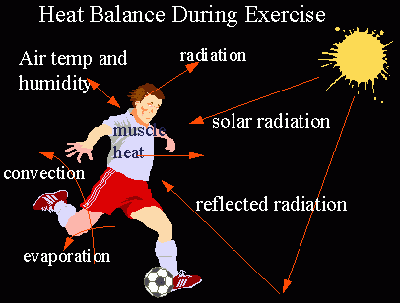
High Temperature Environments
When the outside temperature nears normal human body temperature, the human body loses its ability to efficiently cool itself.
Blood circulated to the skin cannot lose heat, and sweating may not occur in humid environments.
Loss of Heat Balance: Heat illness results when the body is out of heat balance. Heat balance means that the heat the body produces equals the heat it looses. When the body is out of Heat balance it produces and retains more heat than it looses causing heat illness.

Slide 7
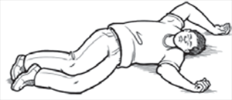
Excess Core Body Heat
If the body cannot get rid of excess heat, it will store it.
When this happens, the body's core temperature rises and the heart rate increases. As the body continues to store heat, the person begins to lose concentration and has difficulty focusing on a task, may become irritable or sick, and often loses the desire to drink.
The next stage is most often fainting and even death if the person is not cooled down.

Slide 8
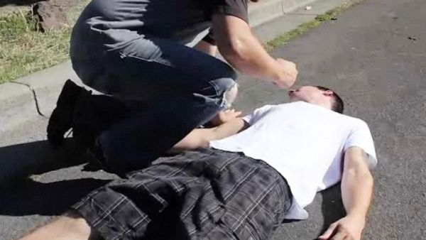
Types of Heat Illness – Heat Stroke
Heat Stroke
Most serious form of heat illness
Results from body being unable to control internal temperature
Symptoms:
Hot body temperature (over 103 degrees F)
Red, hot and dry skin
Rapid, strong pulse
Dizziness
Nausea
Confusion
Unconsciousness

Slide 9
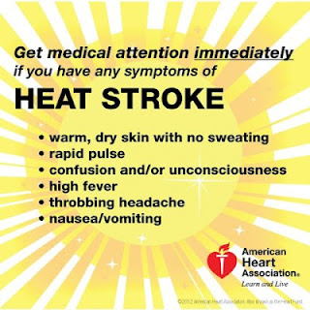
What are the signs of Heat Stroke?
May be confused
May be unable to think clearly
May pass out
May collapse
May have seizures (fits)
May stop sweating.

Slide 10
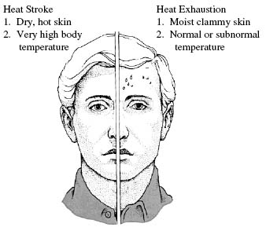
Types of Heat Illness – Heat Exhaustion
Heat Exhaustion
Milder form of heat illness than Heat Stroke
Can develop after several days of exposure with inadequate replacement of fluids
Symptoms:
Heavy Sweating
Paleness
Muscle Cramps
Tiredness
Weakness
Dizziness
Headache
Nausea or vomiting
Fainting

Slide 11
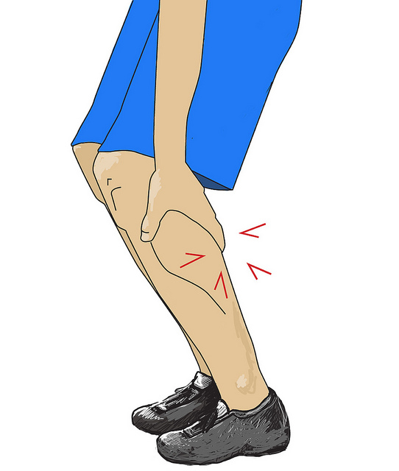
Types of Heat Illness – Heat Cramps
Heat Cramps
Muscle pains or spasms
Caused by low salt levels in muscles from excessive sweating
May also be a symptom of heat exhaustion

Slide 12
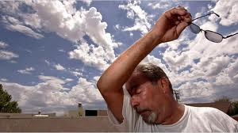
Risk Factors
Certain factors can increase the risk of heat illness.
Age (greater risk if over 65)
Sudden temperature changes
Health conditions
Medications and/or alcohol
Obesity
Clothing, personal protective equipment

Slide 13
Section 2: Heat Illness Prevention
Water Consumption
Rest and Shade

Slide 14
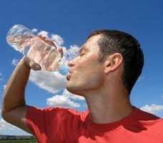
Water consumption
Replenishing fluids lost from sweating is essential. Frequent consumption of small amounts of water is best.
Consider drinking up to 4 cups of water per hour.
Sources of Water:
Personal water bottles
Water coolers on SCU vehicles
Plumbed water coolers
Buildings with water bottle refill stations

Slide 15
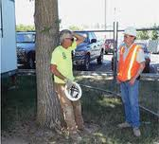
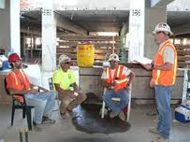
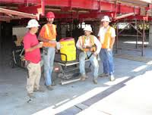
Rest and Shade
If feeling overheated, rest in indoor or shaded area for at least 5 minutes. SCU has over 2,000 trees and 60 buildings accessible to provide shade. Portable shade canopies are available if needed.
Employees should notify their supervisor if they need time in the shade to cool off (no matter the temperature).

Slide 16
Section 3: Emergency Response
Notification Procedures
Interim Measures

Slide 17
Notification Procedures
If you or someone you are working with shows signs of heat illness:
Call SCU Campus Safety: 408-554-4444 or
Call 9-1-1
If you call 911 first, call SCU Campus Safety immediately following
Notify your supervisor immediately
All injuries, accidents, incidents and emergencies must be reported
Be prepared to describe the incident to emergency responders and meet and guide them to the scene

Slide 18
Interim Measures
While awaiting for emergency medical services:
Move the person to a cooler place to rest.
Give the person water as long as he/she is not losing consciousness or vomiting
Loosen the person’s clothing
Never leave a person who is experiencing signs/symptoms of heat illness

Slide 19
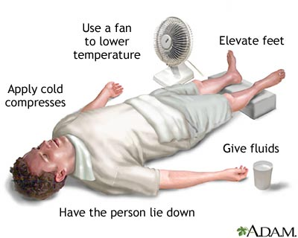
Interim Measures
Help cool the person. Fan the person, put ice packs on the person’s groin and underarms, or soak the person’s clothing with cool water

Slide 20
Supervisors – Hot Weather Procedures
When outdoor temperatures equal or exceed 95 degrees Fahrenheit:
Periodically monitor employees for signs of heat illness
Remind and encourage employees to consume plenty of water
Ensure employees have access to shade for rest breaks
Make sure employees have an effective way of getting a hold of you in an emergency.
Supervisors have the ability to postpone outdoor activities until the weather cools down.

Slide 21
Rapid Onset
Heat illness can develop very rapidly and is not always obvious before it becomes life-threatening. During high heat, heat illness can develop faster and even employees who have been doing their job for sometime are a risk.
Employees should be encouraged to never to discount any discomfort or symptoms they are experiencing when working in heat, after work or before the next workday. Heat illness symptoms can occur even after work has stopped. They should immediately report any problems they are experiencing to a supervisor and coworker, supervisor or CSS and seek prompt medical attention.
Heatstroke is usually fatal unless emergency medical treatment is provided promptly.

Slide 22
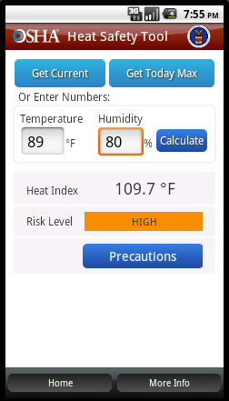
Supervisors – Heat Stress Monitoring Tool
Smart phone app for heat stress evaluation can be found at https://www.osha.gov/SLTC/heatillness/heat_index/heat_app.html
Application calculates a heat risk level and recommends certain precautions based on the risk. It provides a forecasted daily high temperatures for your location.

Slide 23
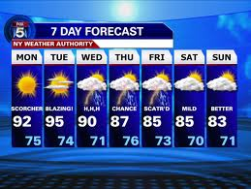
Supervisors – Weather Monitoring
Monitor the weather forecast and implement previously discussed procedures when temperatures are predicted to exceed 95 degrees.

Slide 24
Conclusion
If you have any questions regarding SCU’s requirements for implementing proper Heat Illness Prevention practices, please contact SCU EHS
www.scu.edu/ehs

